Slide 1
Digital Portfolio
STUDENT NAME: NISONIYA M
REGISTER NO AND NMID: 212401017/4E73F3BD0EB477D9D21455A3F69E91F6
DEPARTMENT: COMPUTER APPLICATIONS
COLLEGE: UNIVERSITY OF MADRAS

Slide 2
PROJECT TITLE DIGITAL PORTFOLIO

Slide 3


AGENDA
Problem Statement
Project Overview
End Users
Tools and Technologies
Portfolio design and Layout
Features and Functionality
Results and Screenshots
Conclusion
Github Link
3/21/2024 Annual Review

Slide 4

PROBLEM STATEMENT
In the modern academic and professional world, individuals need an effective way to showcase their skills, achievements, and projects beyond traditional resumes. A digital portfolio provides a structured and visually appealing platform to present personal information, technical skills, educational background, projects, and contact details in one accessible space.
However, many students and professionals face challenges in creating such portfolios due to limited knowledge of web technologies, lack of design awareness, and difficulty in maintaining and updating their work systematically.

Slide 5
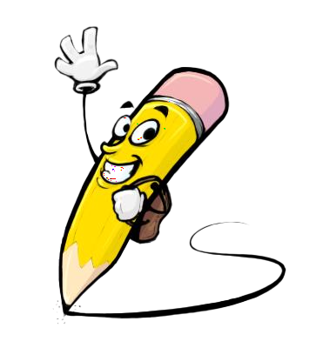
PROJECT OVERVIEW
The Digital Portfolio Project is designed to create a personal, interactive, and professional platform for showcasing an individual’s identity, skills, and achievements. Unlike a traditional resume, which provides limited space and static information, a digital portfolio offers a dynamic and engaging way to present details such as personal background, technical and soft skills, academic qualifications, projects, certifications, and contact information.

Slide 6

WHO ARE THE END USERS?
Students – to showcase skills and projects.
Job Seekers/Professionals – to present career achievements.
Recruiters/Employers – to evaluate candidates.
Teachers/Mentors – to review student work.

Slide 7

TOOLS AND TECHNIQUES
HTML – for structuring web pages.
CSS – for styling and layout design.
JavaScript – for interactivity and dynamic features.
Code Editor – VS Code / Sublime Text for development.
Version Control – Git & GitHub for storing and sharing code.
Responsive Design – Media queries & frameworks (Bootstrap/Tailwind).

Slide 8
POTFOLIO DESIGN AND LAYOUT
Home / About Me – Introduction, photo, and personal details.
Skills – Technical and soft skills displayed with icons or progress bars.
Projects – Showcase of academic or professional projects with descriptions.
Resume / Achievements – Education, certifications, and accomplishments.
Contact – Email, phone, social media, or contact form.
8

Slide 9
FEATURES AND FUNCTIONALITY
Responsive Design – Works on mobile, tablet, and desktop.
Navigation Menu – Easy access to all sections.
Interactive Sections – About, Skills, Projects, Resume, Contact.
Project Showcase – Images, descriptions, and links to work.
Contact Form / Links – Direct communication via email or social media.
Clean UI/UX – Simple, attractive, and user-friendly interface.

Slide 10

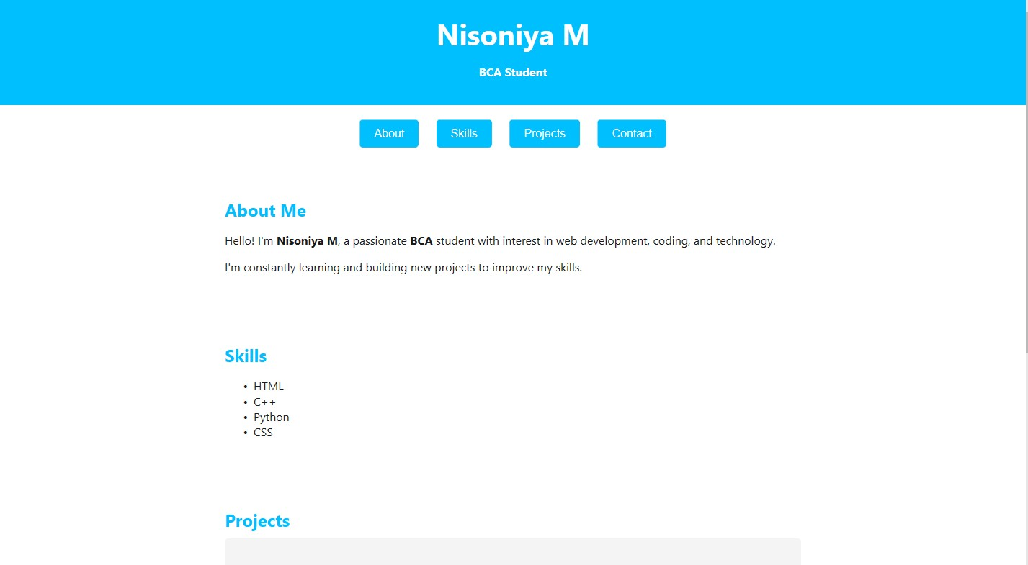
RESULTS AND SCREENSHOTS
Developed a responsive and user-friendly digital portfolio.
Organized sections: About Me, Skills, Projects, Contact.
Easy navigation and attractive design.
3/21/2024 Annual Review
10

Slide 11
CONCLUSION
The Digital Portfolio successfully showcases personal details, skills, and projects in a structured and interactive way. It provides a responsive, user-friendly platform that can be used for academics, job applications, and professional growth.
11

Slide 12
GITHUB LINK
https://13538bca2024-cell.github.io/-M.NISONIYA/

